Slide 1
Neural Network Machine Learning Deep Leaning

Slide 2
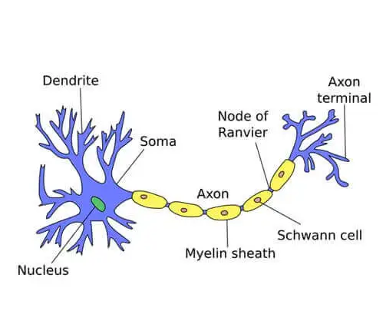

Slide 3
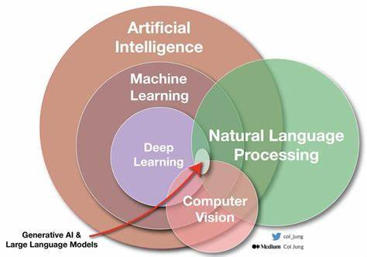

Slide 4
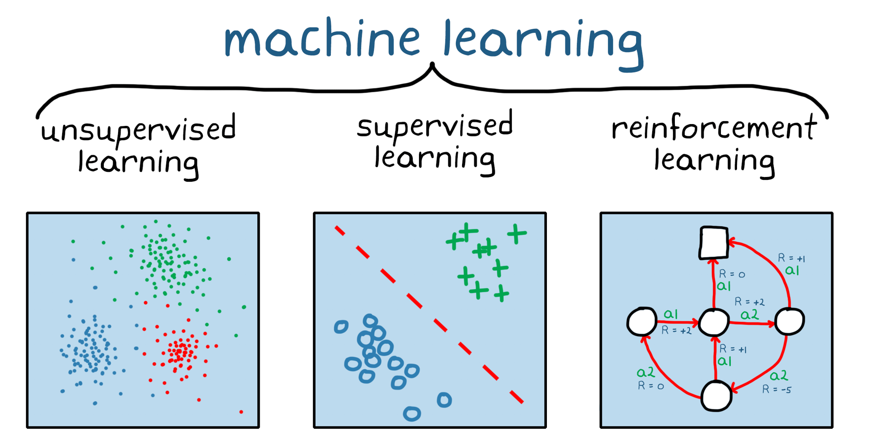
Machine Learning :
Supervised Learning
Classification – Categorical ( Dog – Cat )
Regression - contiguous ( House Cost )
Unsupervised Learning
Clustering ( anomaly Detection )
Reinforcement Learning
Agent and Environment
Action - Reward and penalty

Slide 5
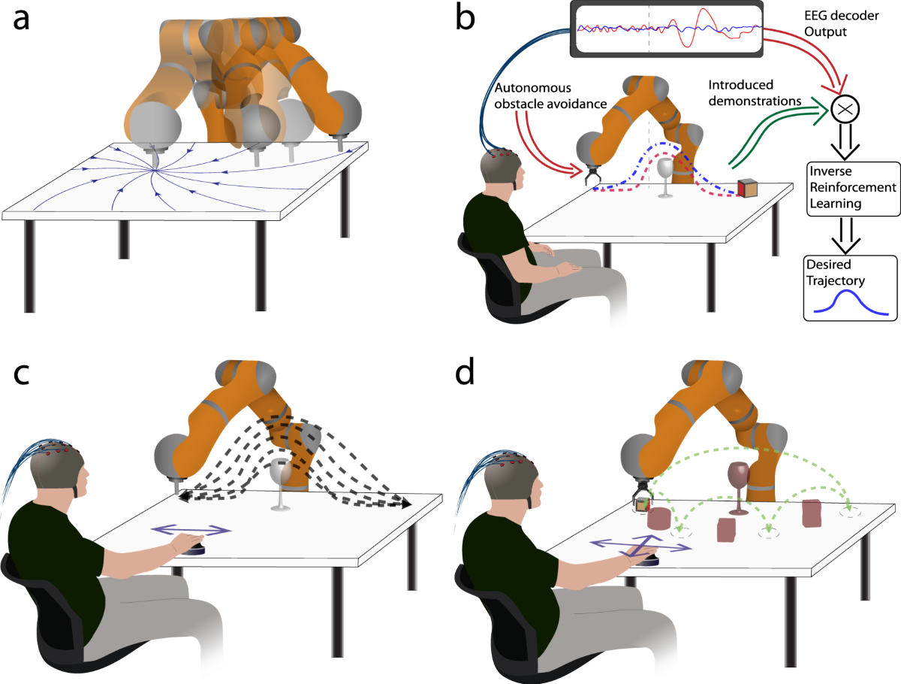
Reinforcement Learning

Slide 6
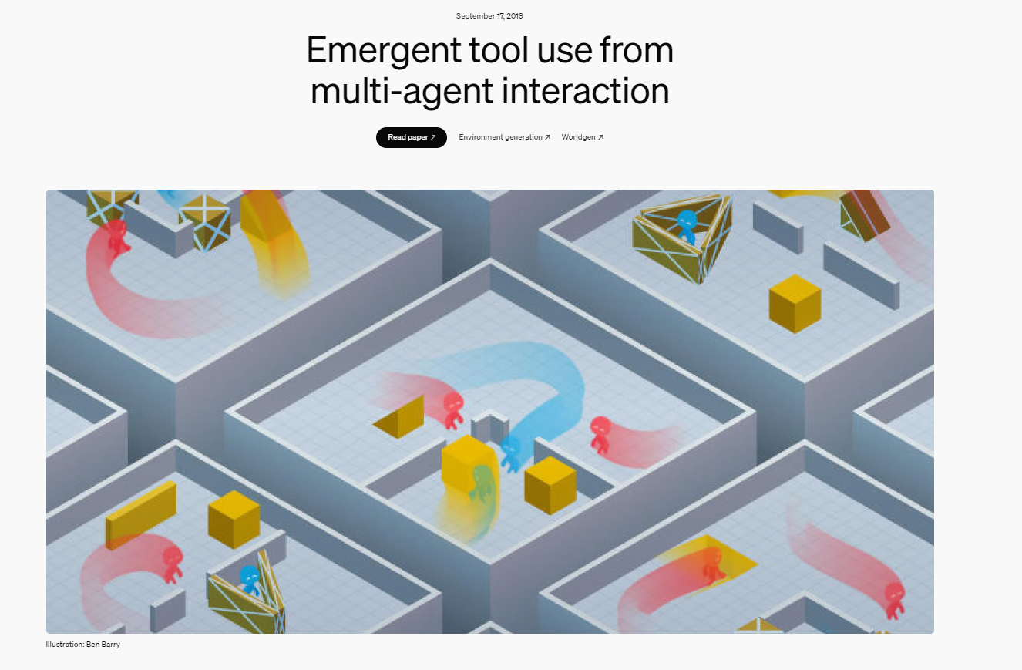
https://openai.com/index/emergent-tool-use/

Slide 7
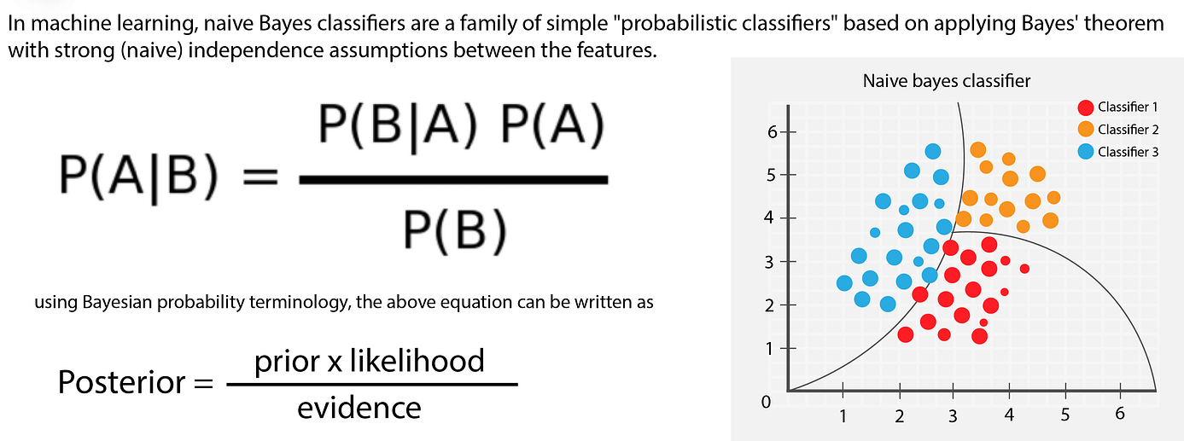
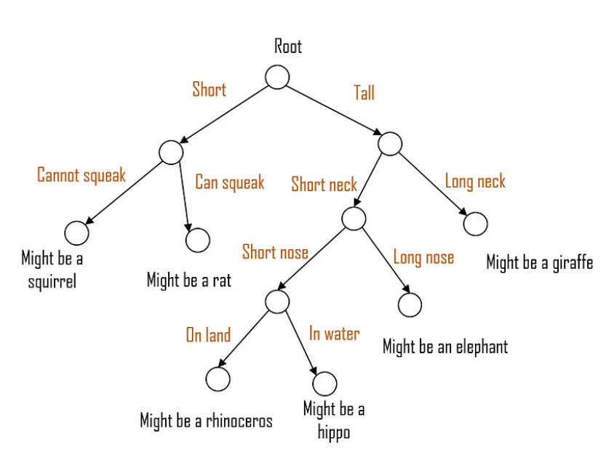
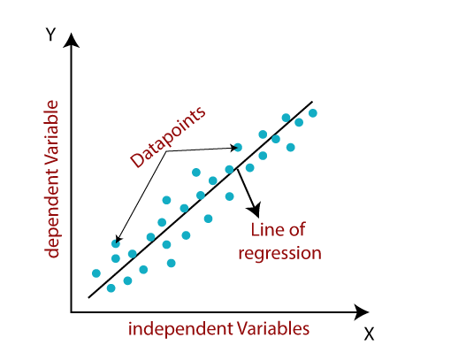
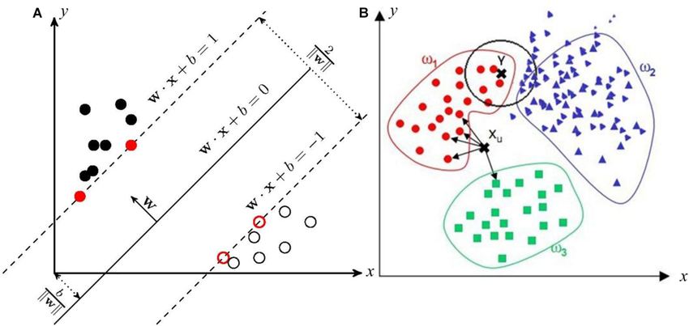
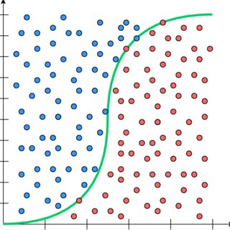
Traditional Neural Network
KNN ( K – Nearest Neighbor )
SVN ( Supper Vector Machine )
Liner Regression
Logistic Regression
Decision Tree
Naïve Bayesian Classifier

Slide 8
K - Nearest Neighbor
K - Nearest Neighbor
If Noise appeared in data this algorithm is not efficient
If K = 1 this algorithm is not efficient
1-nn
3-nn

Slide 9
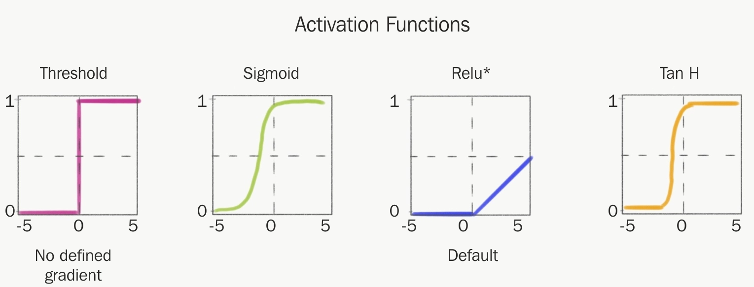
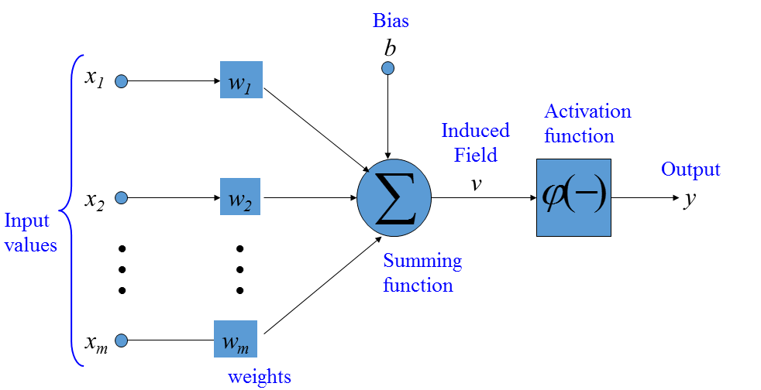
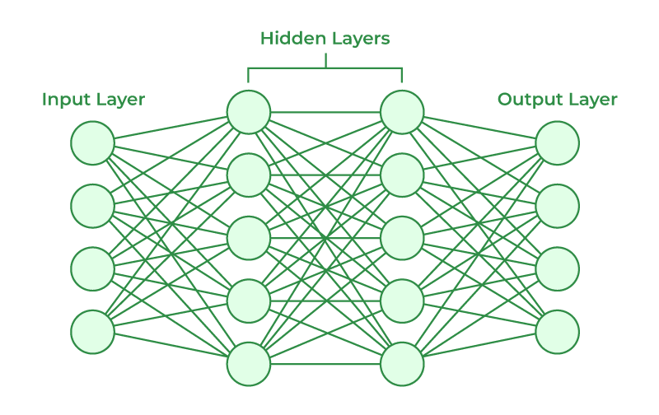
Natural Network
Fully Connected layer

Slide 10
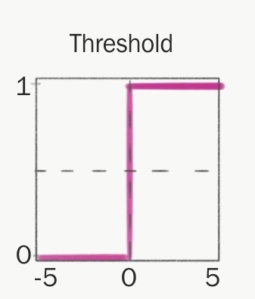
Perceptron
W1
X1
+
FEED FORWARD Network
AF
W2
X2
AF((X1*W1 + X2 * W2) + b )
b
bias
1
AF((0.8*0.3 + 0.9 * 0.2) + 1 ) = AF(5.2) = 1
AF((0.7*0.3 + 0.6 * 0.2) + 1 ) = AF(1.33) = 1
X1 | X2 | Label
0.8 | 0.9 | 1
0.7 | 0.6 | 1
0.3 | 0.2 | 0
AF((0.3*0.3 + 0.2 * 0.2) + 1 ) = AF(1.13) = 1
Error
0
0
1
w1 | w2
0.3 | 0.2

Slide 11
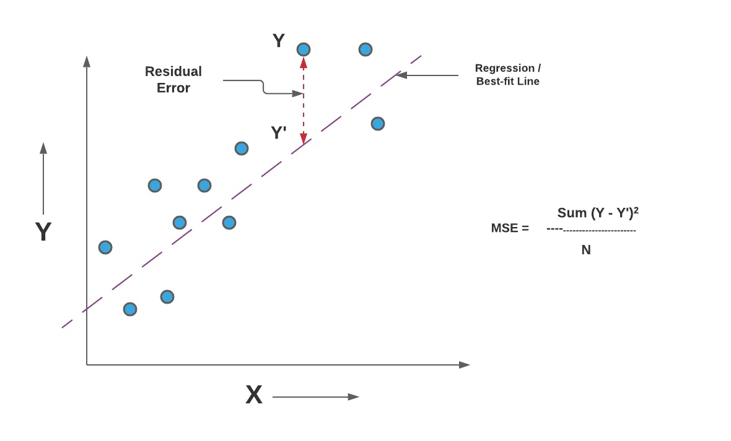
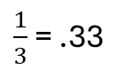
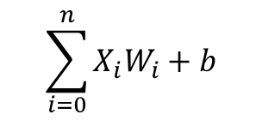
Loss Function and Back Propagation
X1
W1
Error
0
0
1
$\frac{1}{3}$ = .33
+
AF
Error
w1 | w2
0.3 | 0.2
X2
W2
b
.3 – (.3 * .33 )
.2 – (.2 * .33 )
Update
w1 | w2
0.201 | .134
$$\sum_{i=0}^{n}{X_{i}W_{i}+b}$$

Slide 12
bias
.5
0
+
AF
0
0
3
b
Changing the output of the perceptron regardless of the inputs and weights.
It is not received from the user
it will change during network training, just like the weights.
The bias functions as the intercept for the neural network.

Slide 13
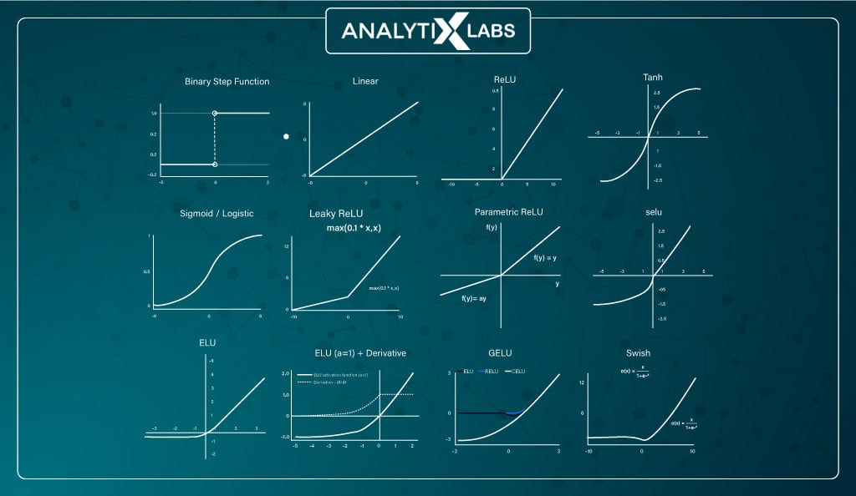
Activation Function | nonlinear functional
https://www.desmos.com/

Slide 14
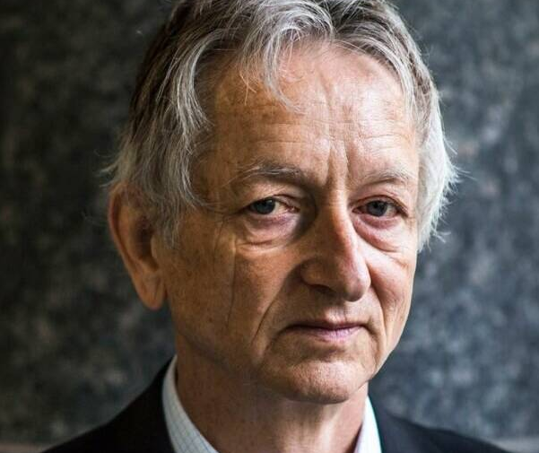
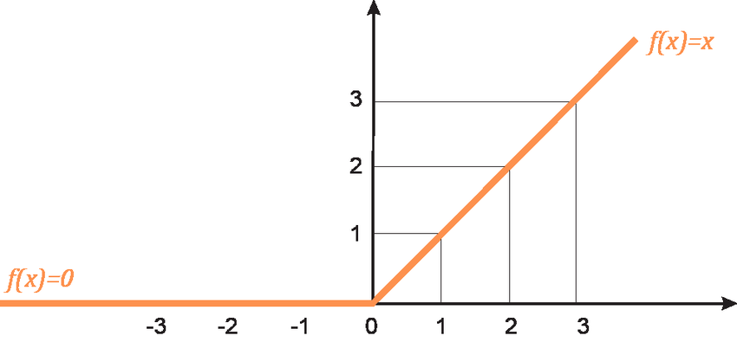
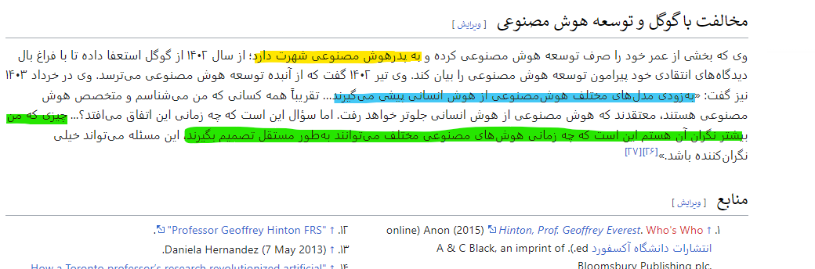
Start of Deep Learning
2008 (Geoffrey Everest Hinton)
ReLU (rectified linear unit )
Max(0,z)

Slide 15
Question
Should we assign an activation function to all perceptron's or not?
https://www.desmos.com/

Slide 16
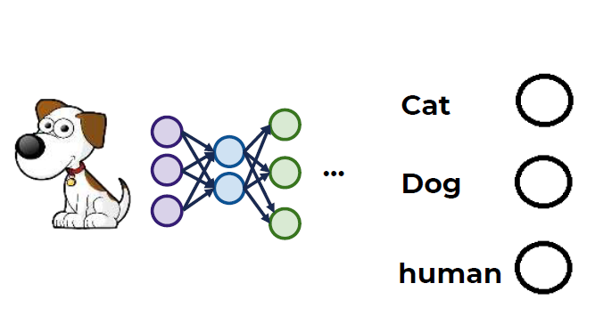
One Hot - Cost or Loss Function
One Hot label
Y
Y’
0.2
0.6
0.2
0
1
0
0.2
0.4
0.2
Loss Function : Average error of one samples
Cost Function : Average error of all samples

Slide 17
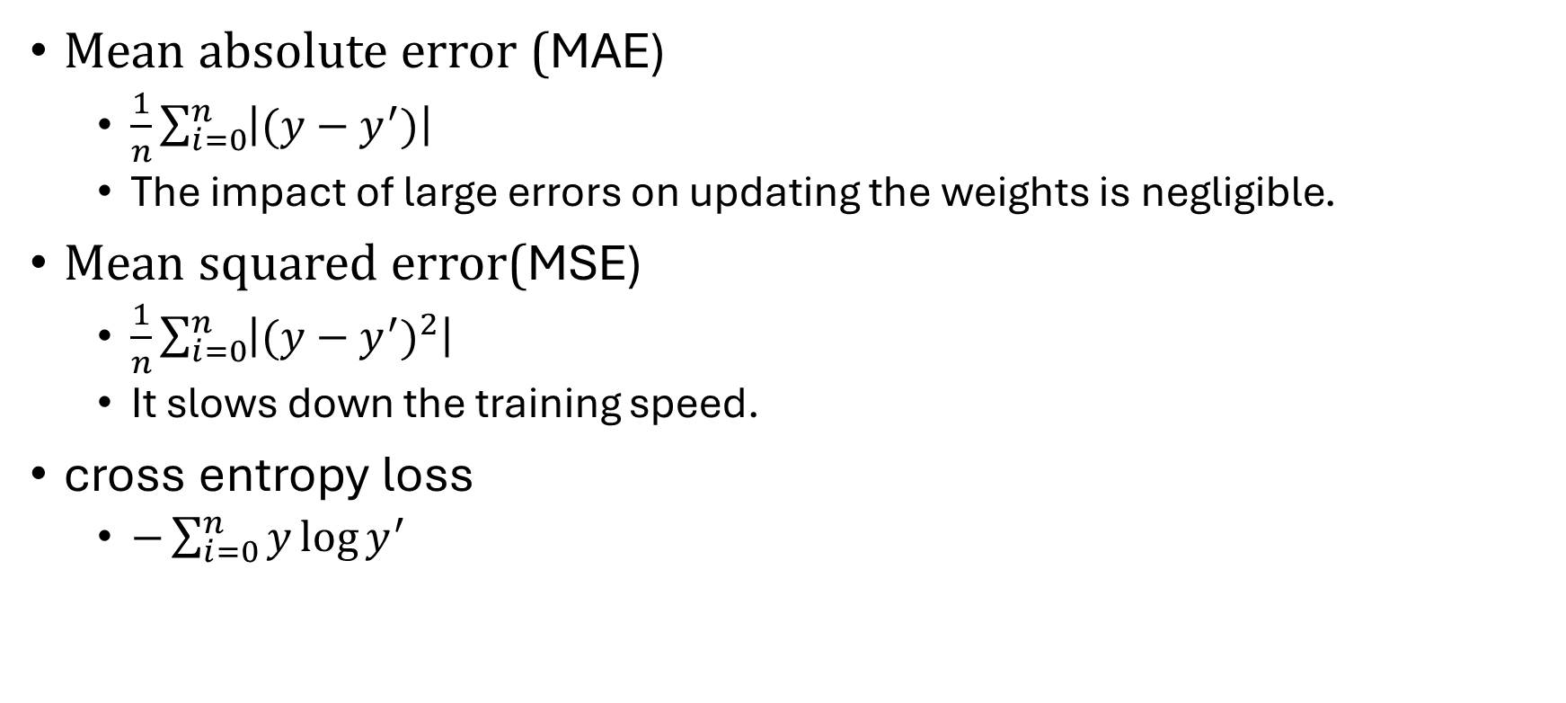
Cost Function
Mean absolute error (MAE)
$\frac{1}{n}\sum_{i=0}^{n}{\left|(y−y^{′})\right|}$
The impact of large errors on updating the weights is negligible.
Mean squared error(MSE)
$\frac{1}{n}\sum_{i=0}^{n}{\left|{(y−y^{′})}^{2}\right|}$
It slows down the training speed.
cross entropy loss
$−\sum_{i=0}^{n}{y\log{y^{′}}}$

Slide 18
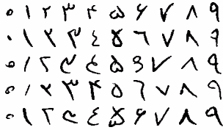
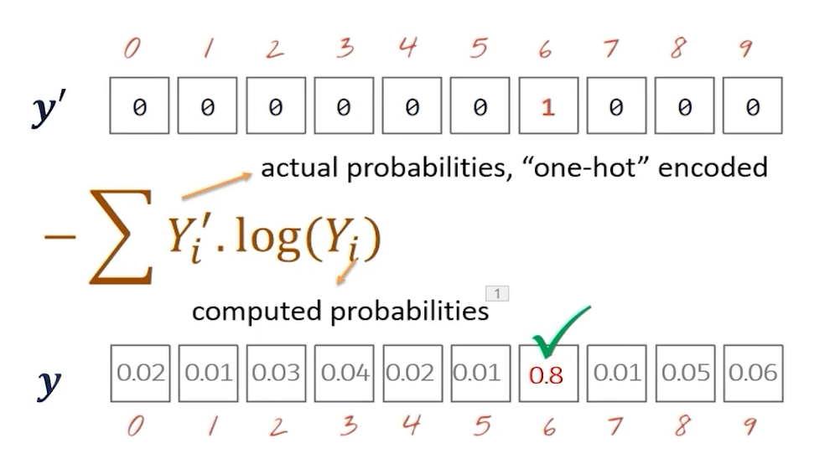
Cost Function

Slide 19
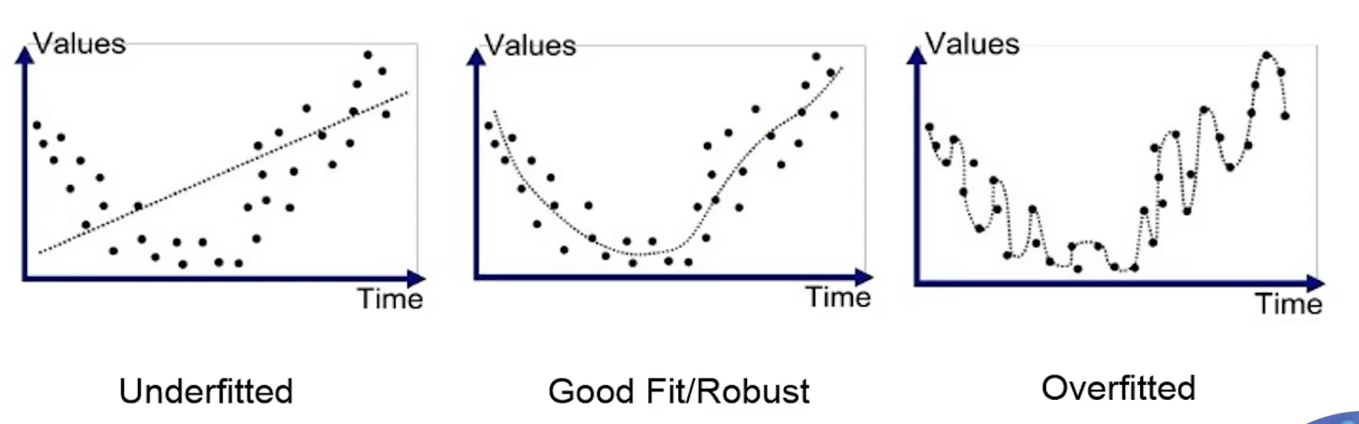

Slide 20
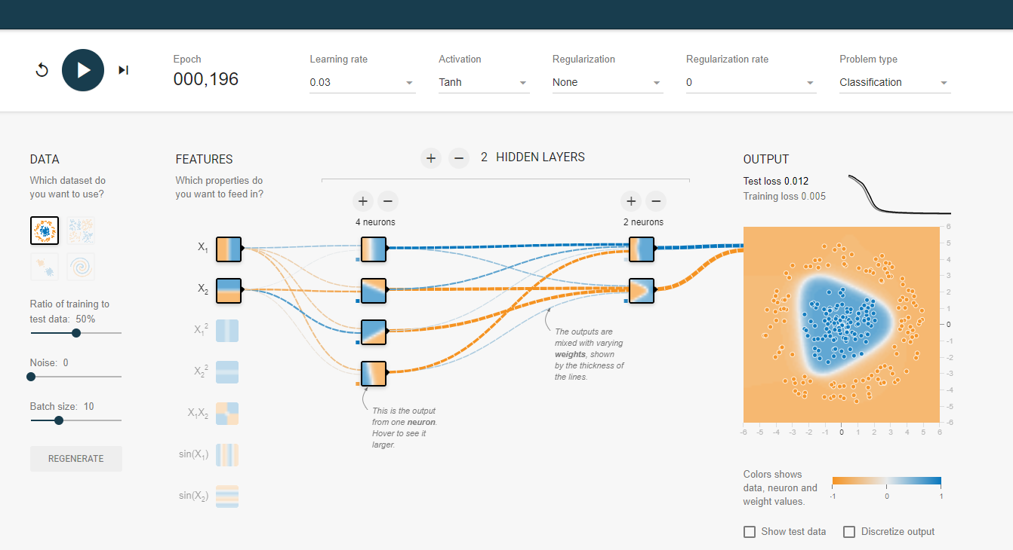
Neural network in Visual
Playground TensorFlow

Slide 21
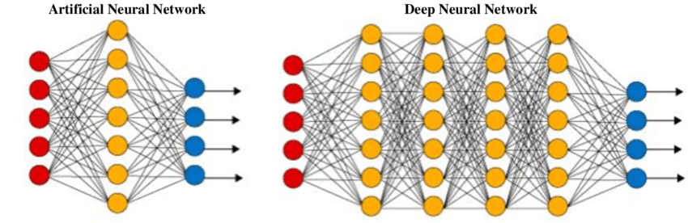
Neural Network Vs Deep Neural Network

Slide 22
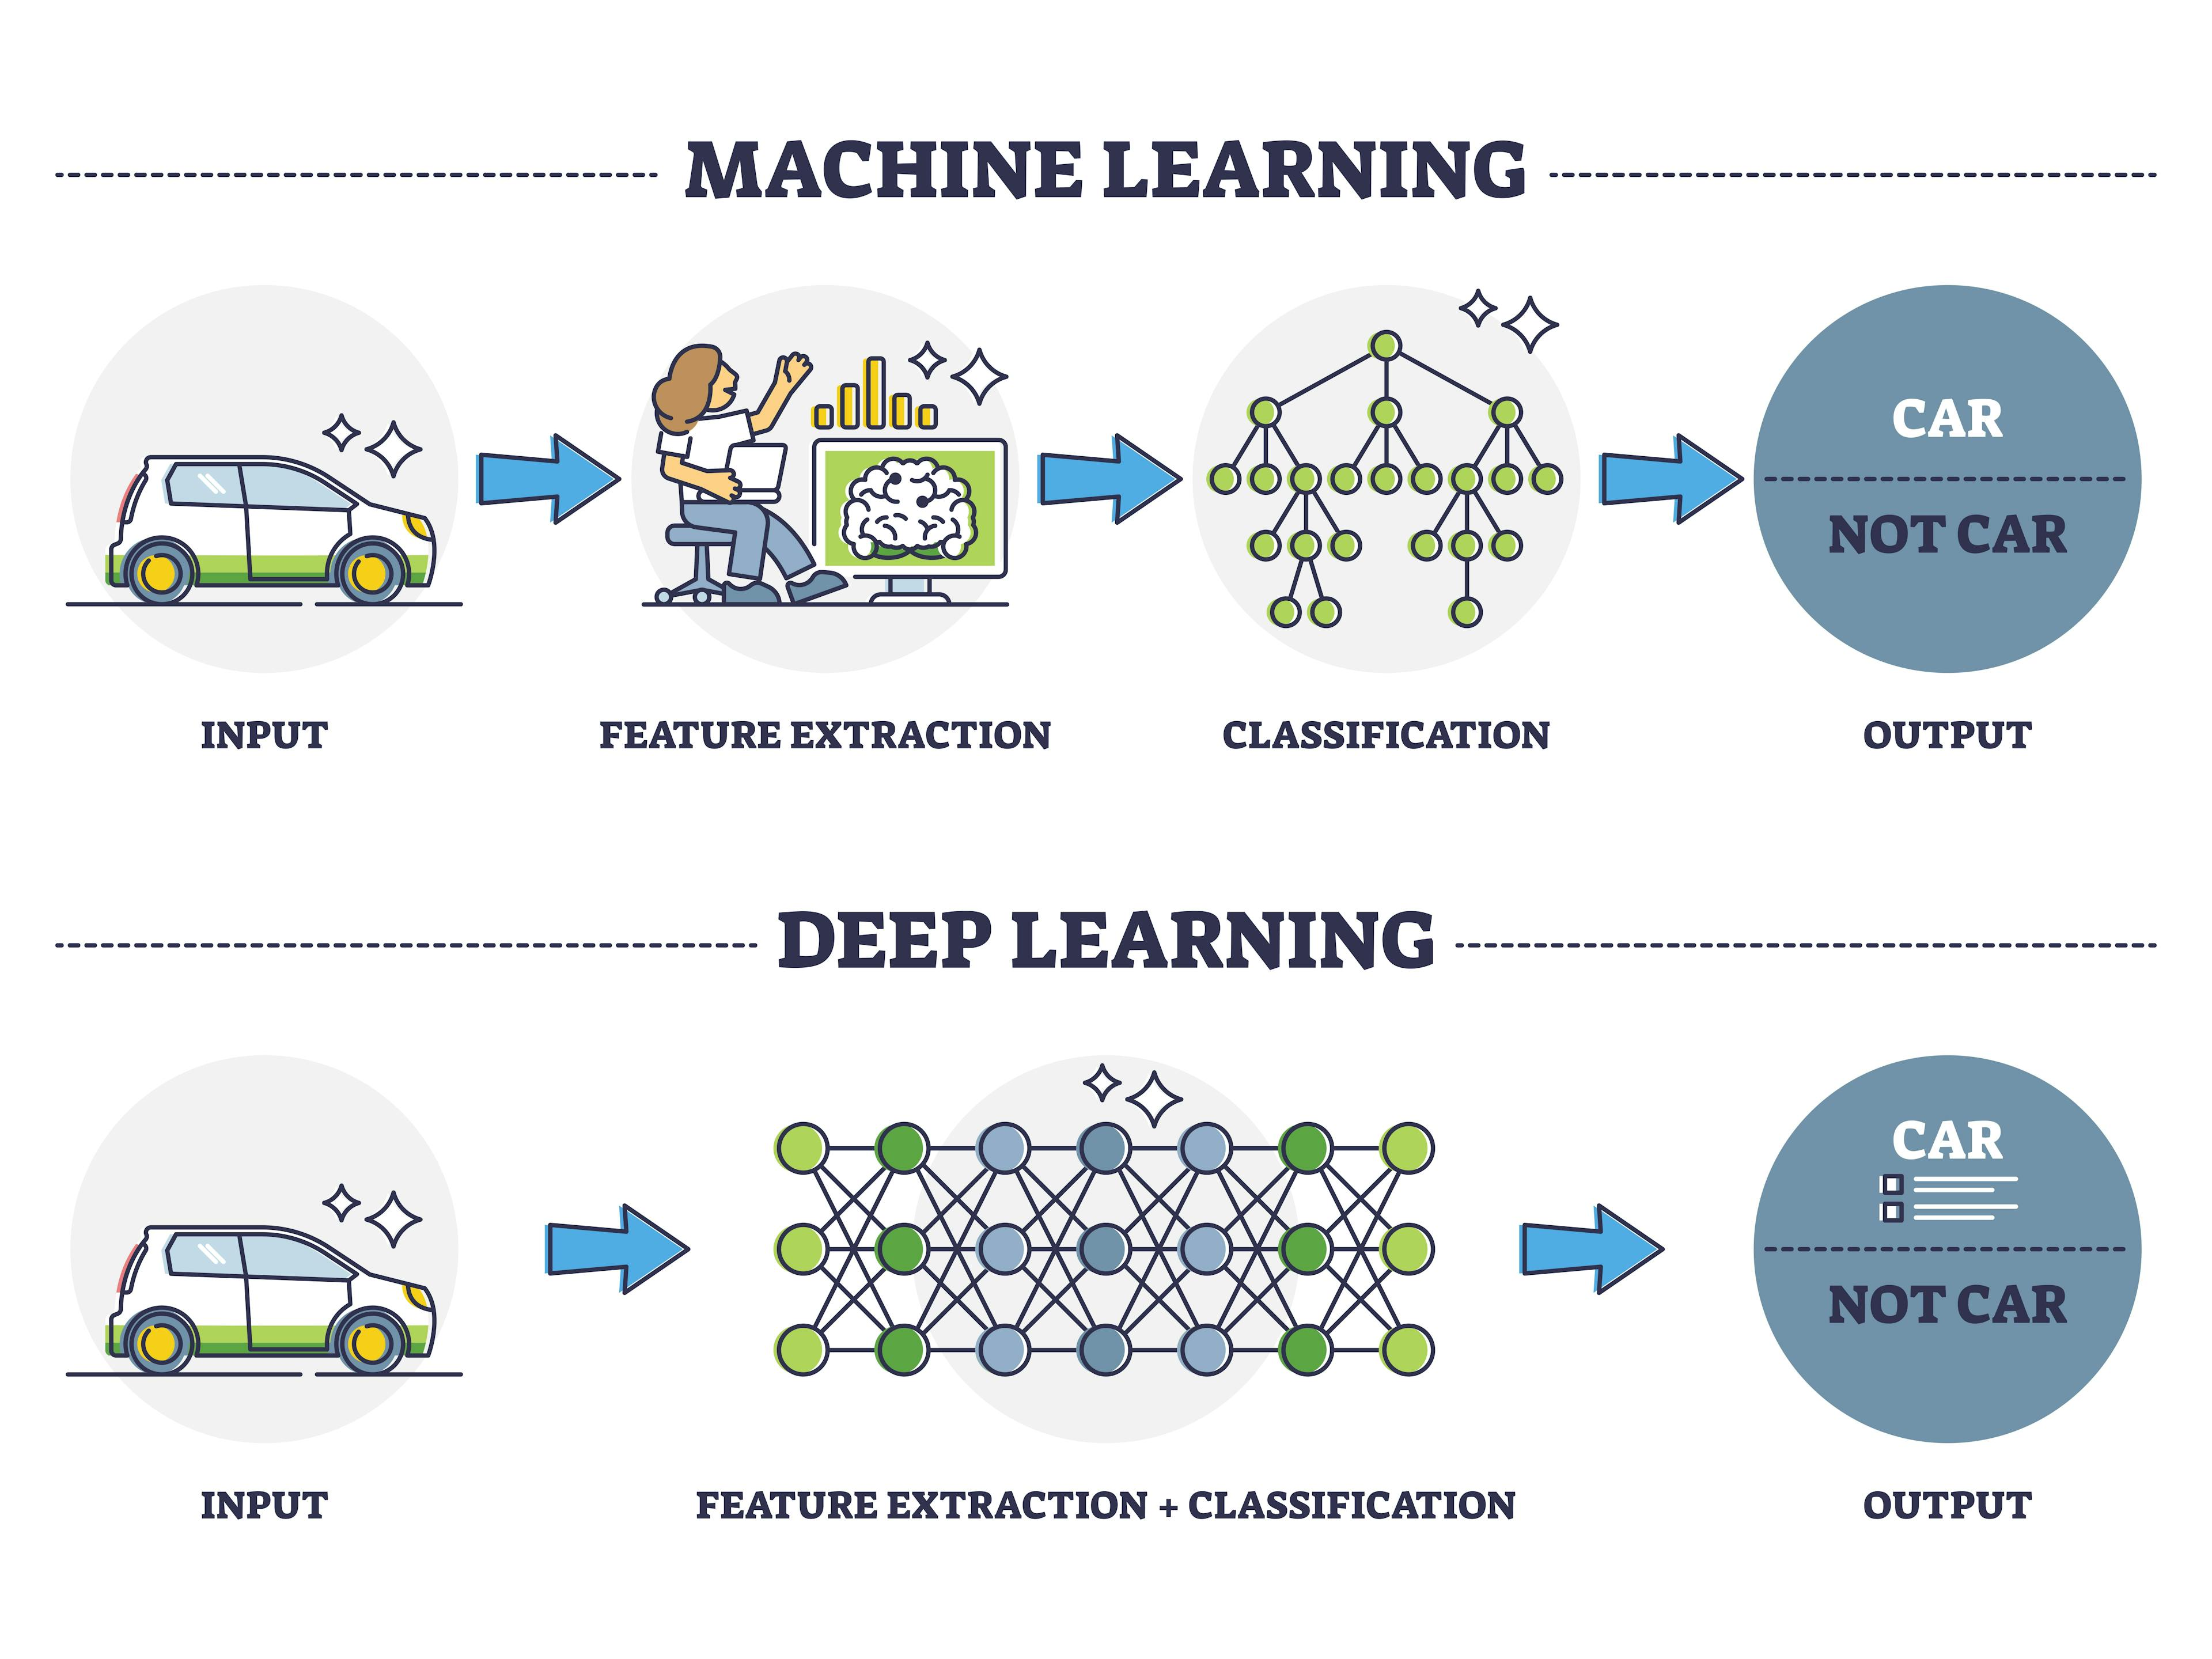
Machine Learning Vs Deep Learning

Slide 23
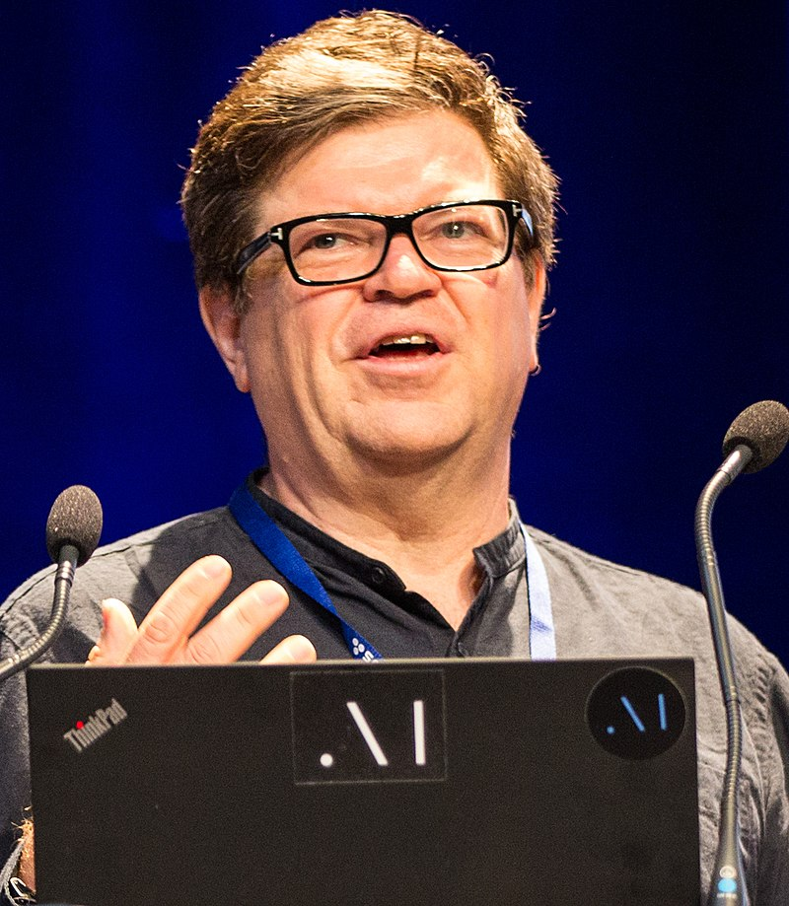
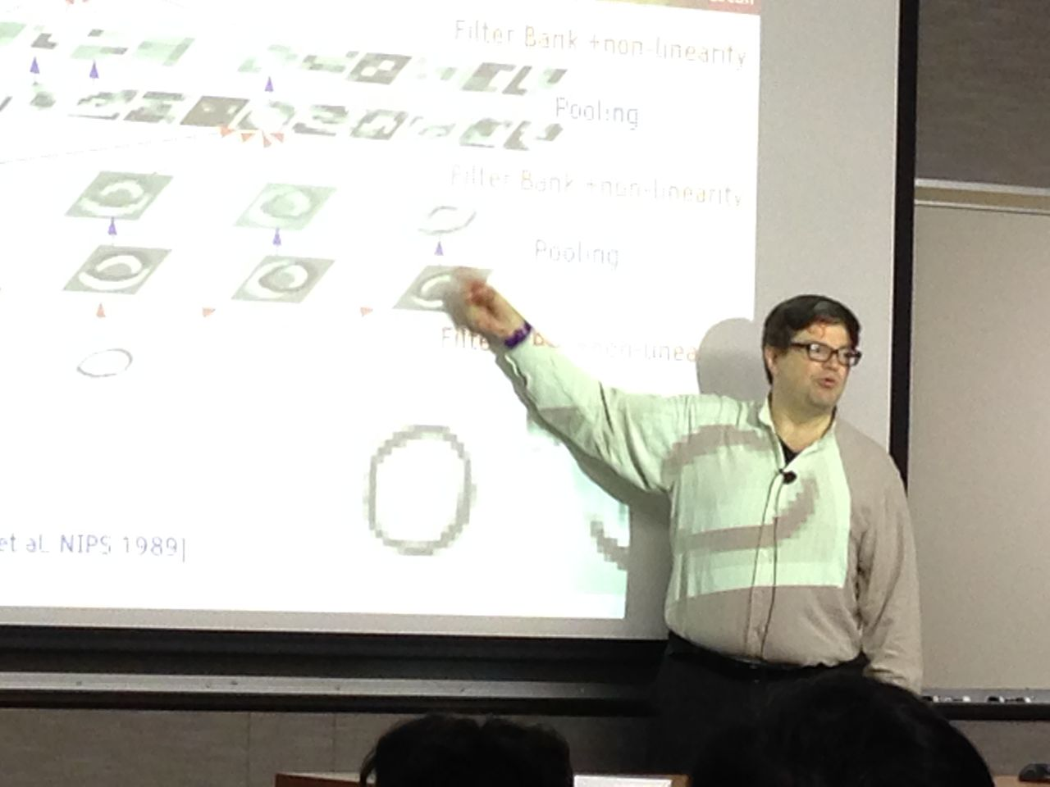
Yann André LeCun
Yann André LeCun^{[1]} (/ləˈkʌn/ lə-KUN, French: [ləkœ̃];^{[2]} originally spelled Le Cun;^{[2]} born 8 July 1960) is a French-American computer scientist working primarily in the fields of machine learning, computer vision, mobile robotics and computational neuroscience. He is the Silver Professor of the Courant Institute of Mathematical Sciences at New York University and Vice-President, Chief AI Scientist at Meta.^{[3][4]}
He is well known for his work on optical character recognition and computer vision using convolutional neural networks (CNNs).^{[5][6]} He is also one of the main creators of the DjVu image compression technology (together with Léon Bottou and Patrick Haffner). He co-developed the Lush programming language with Léon Bottou.
In 2018, LeCun, Yoshua Bengio, and Geoffrey Hinton, received the Turing Award for their work on deep learning.^{[7]} The three are sometimes referred to as the "Godfathers of AI" and "Godfathers of Deep Learning"

Slide 24
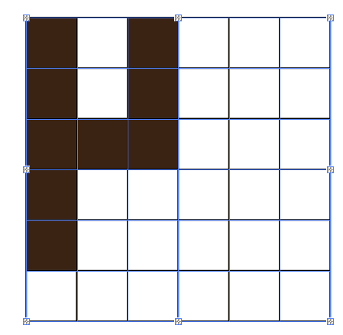
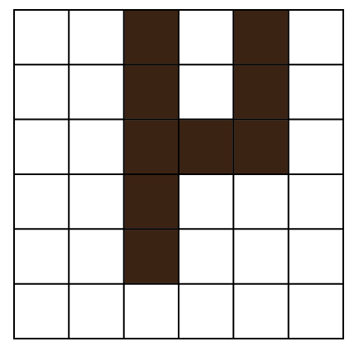
Way Convolution Neural Network ?
earlier ML is useful for Structural Data
Bedroom – Bathroom – age – area
Image is not Structural

Slide 25
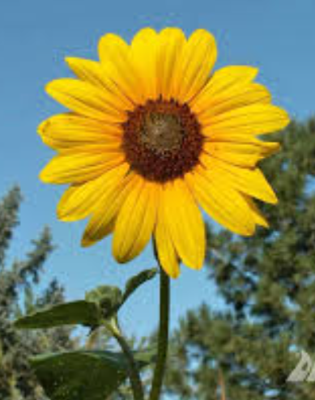


Are they different ?
If the criterion or features are the selection of pixels, these images are no longer equal.
Light
Form
Scale
Distance
Rotation
And ….

Slide 26
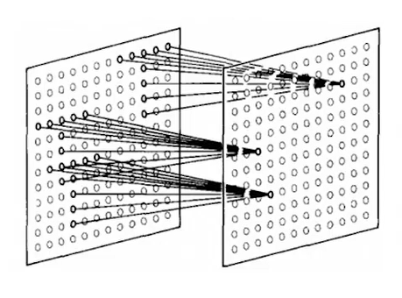
Birth of Convolution
Fukushima
1980 (Neurocognition)
Inspired by the human brain
Don’t use fully connected layer
Use sparse Layer
Yann LeCun
1998 ( gradient base learning )
Neurocognition + Back propagation | Gradian Descend

Slide 27
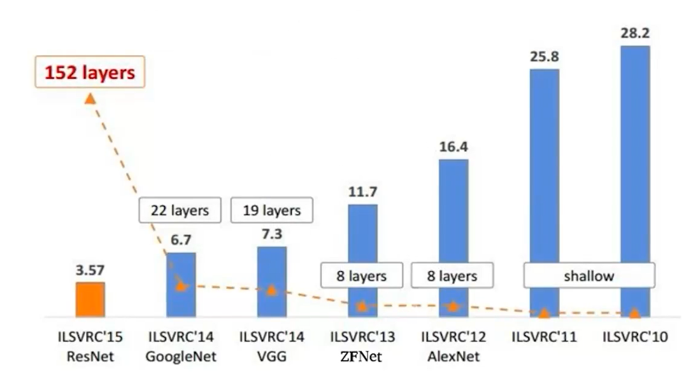
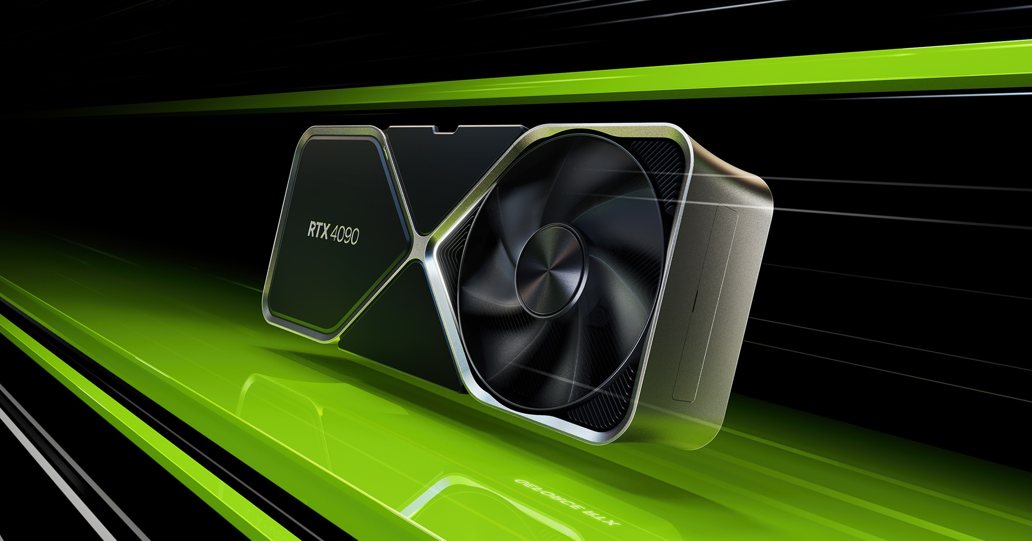
Way so late ? After 18 years
Not enough hardware
Not enough Data
Not enough Knowledge (Activation Function)

Slide 28
Deep Learning
Convolution Neural Network (CNN)
Recurrent Neural Network ( RNN )
Graph Neural Network (GNN)
Attention
Transformers
Diffusion
Large Language Model Neural Network ( LLM )

Slide 29
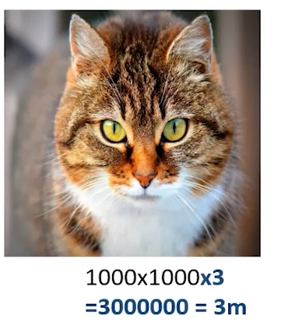
Way Convolution ?

Slide 30
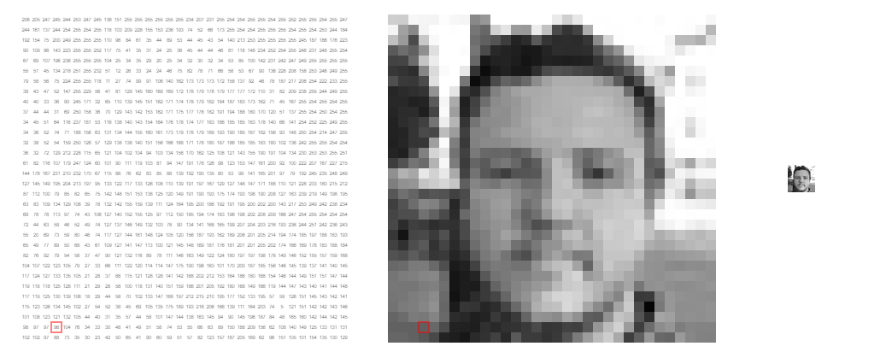
Convolution Kernel
https://setosa.io/ev/image-kernels/

Slide 31
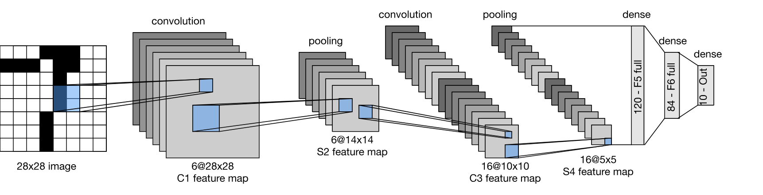
CNN - LeNet

Slide 32
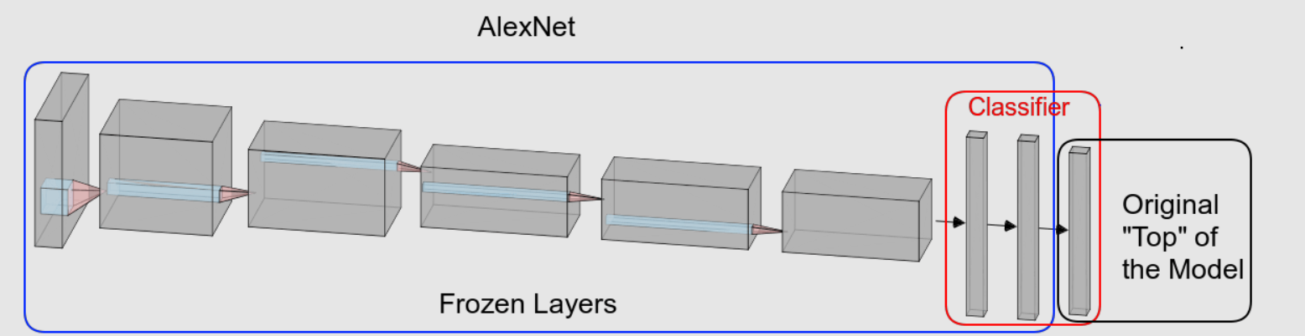
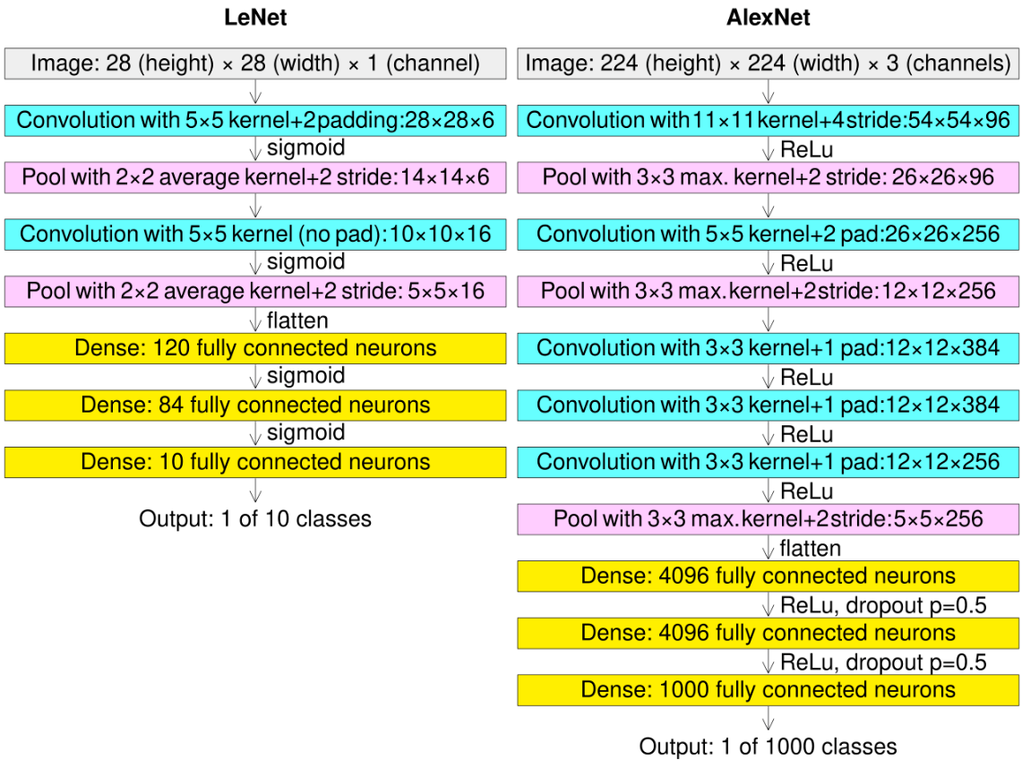
CNN - AlexNet
the name CNN architecture, designed by Alex Krizhevsky

Slide 33
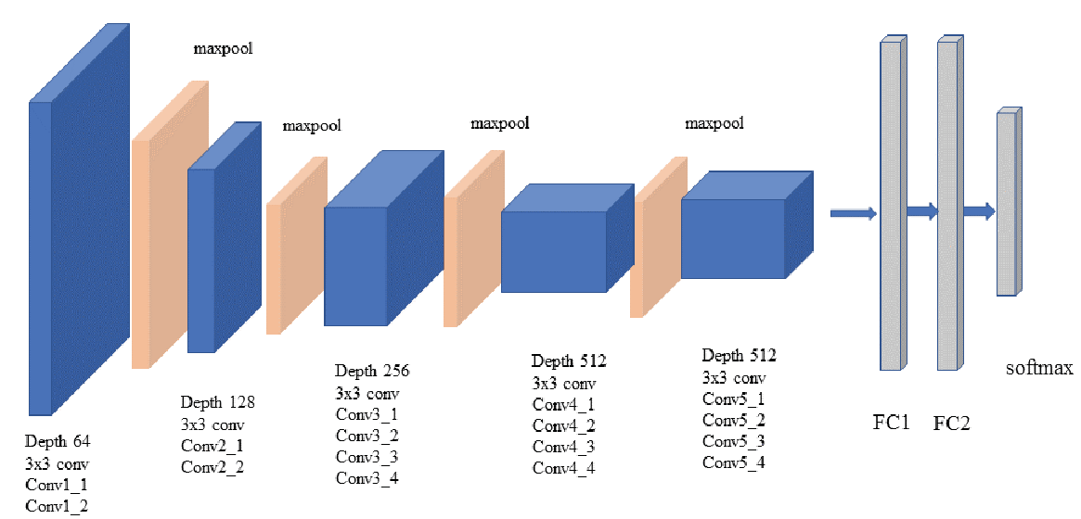
Vgg16

Slide 34
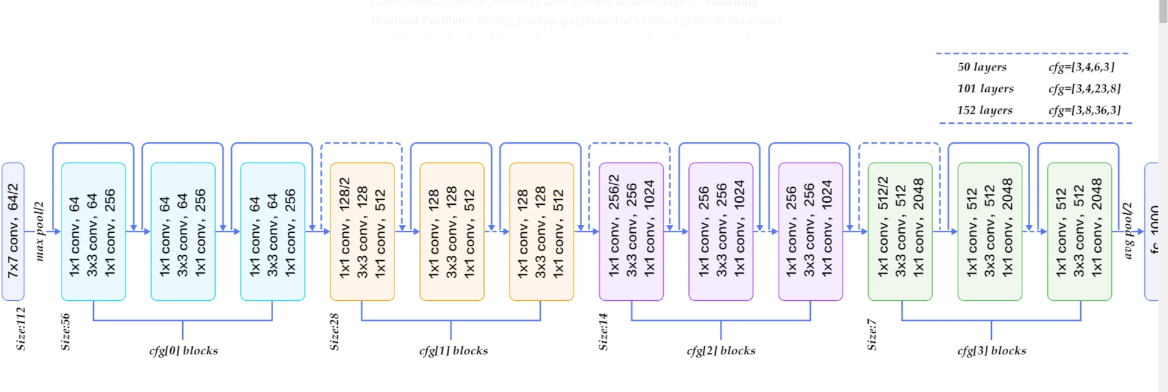
CNN - Residual Networks (ResNet)

Slide 35
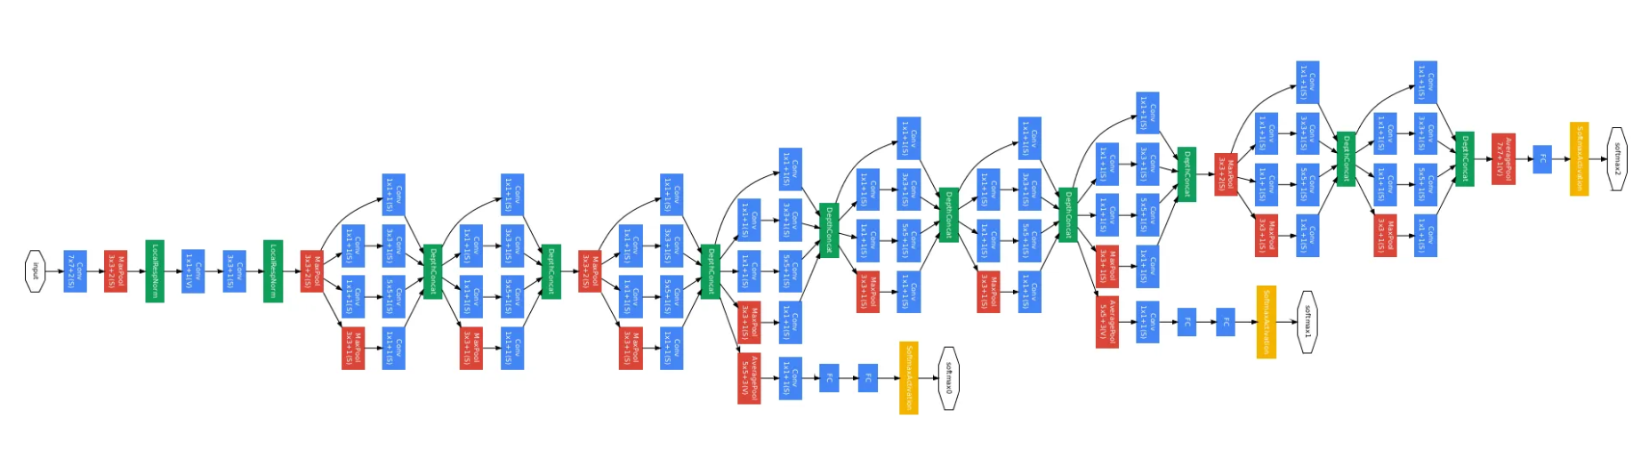
CNN – Inception ( GoogLeNet )

Slide 36
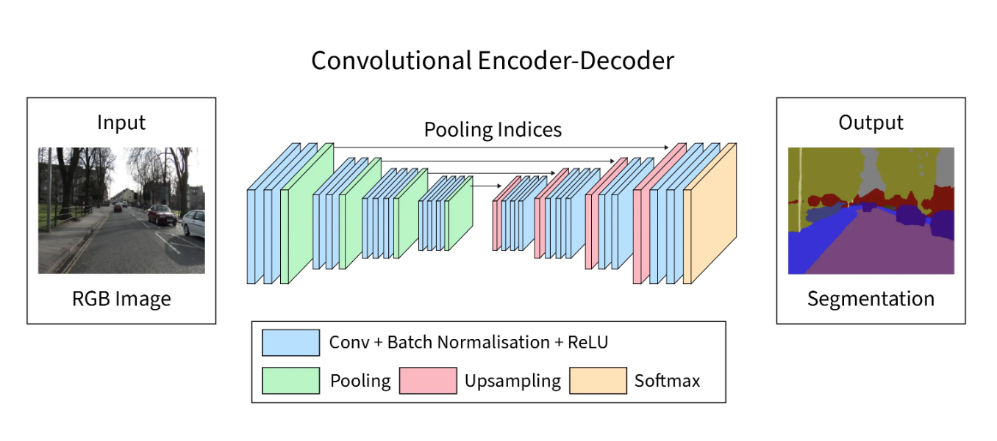
CNN - Decoder-Encoder

Slide 37
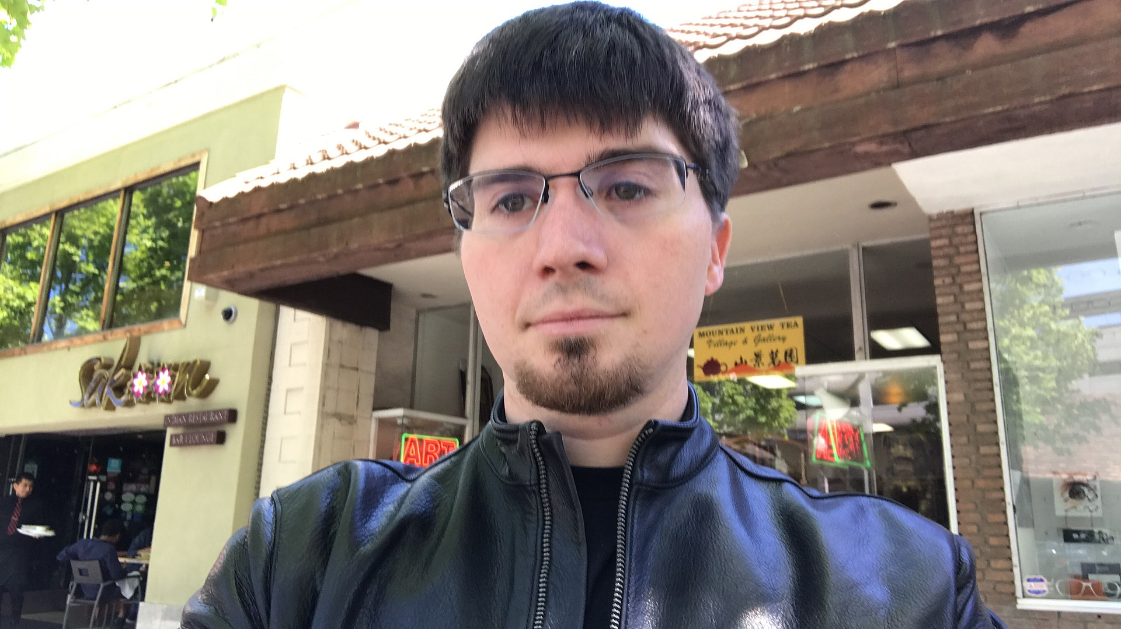
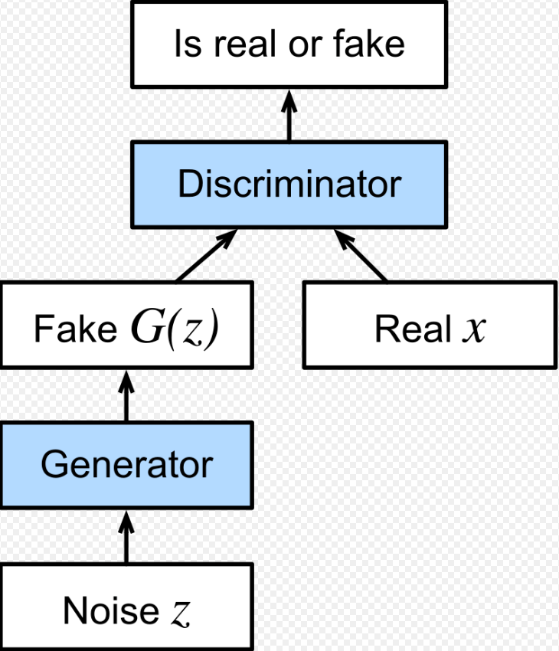
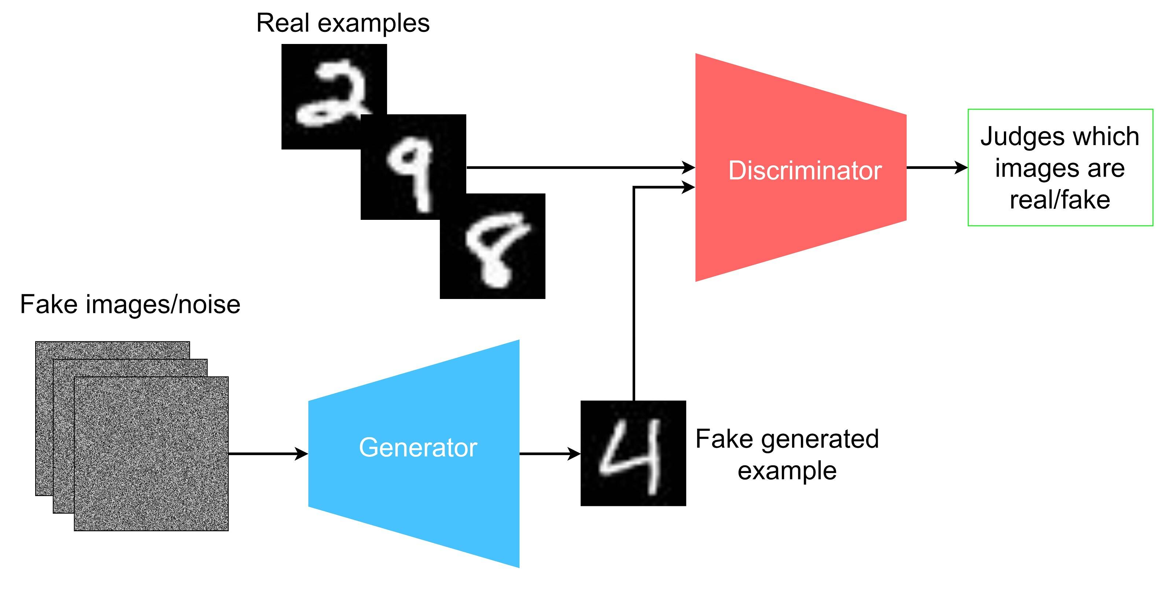
CNN - Generative adversarial network (GAN)
Pix2Pix
Cycle GAN
Ian Goodfellow

Slide 38
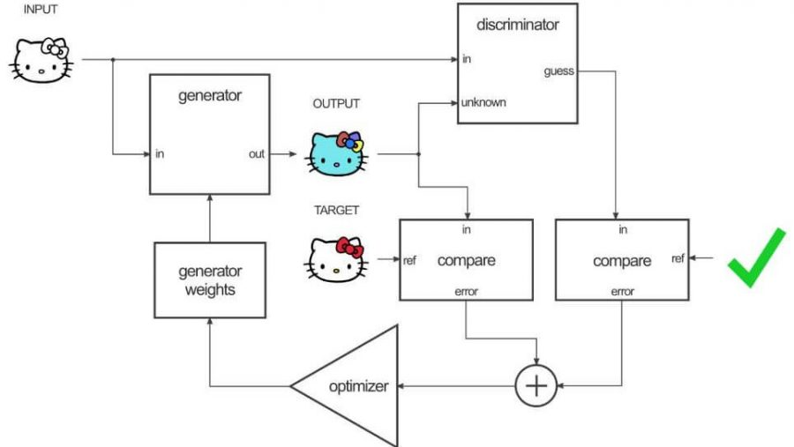

Pix2Pix
https://affinelayer.com/pixsrv/

Slide 39


Style GAN

Slide 40

Cycle GAN

Slide 41


RNN
Start of LLM
Text to Text
Text To Image
Video Labeling
And ….

Slide 42

RNN
This NN has Memory

Slide 43
RNN
I am explaining the neural network
I am explaining the …..

Slide 44

Graph Neural Network
https://distill.pub/2021/gnn-intro/

Slide 45

Attention

Slide 46


Slide 47


Slide 48



Slide 49

LLM
ChatGPT
Copilot
Bert
Lima
Gemini

Slide 50





Requirements
Python
numpy
matplotlib
scikit-learn
pandas
Keras
TensorFlow | pyTorch
google colab

Slide 51
Generative and LLM Site
https://chatgpt.com/
https://runwayml.com/research/gen-2
https://www.midjourney.com/home
https://lumalabs.ai/dream-machine
https://www.adobe.com/products/firefly.html#
https://www.3daistudio.com/

Slide 52

YOLO
You only look once
real-time object detection and image segmentation model
https://docs.ultralytics.com/

